Slide 1
House price predicition using linear regression
MACHINE LEARNING PROJECT
NAME:SARVESHWAR S HIREMATH
COURSE:BCA 5TH SEM
INSTITUTE:DIGITAL DREAMS OF INSTUTION

Slide 2
Problem Statement
House prices depend on area, rooms, location, age
Manual estimation is inaccurate
Goal: Predict price automatically using ML
Linear Regression used for continuous value prediction

Slide 3
Dataset Description
Features in dataset:
• Area (sq ft)
• Number of bedrooms
• Location
• Age of house
Target variable: House Price

Slide 4
Technique & Workflow
- Algorithm: Linear Regression
- Steps:
1. Input data
2. Preprocessing & cleaning
3. Model training
4. Prediction output
- Simple linear model fitting best line

Slide 5
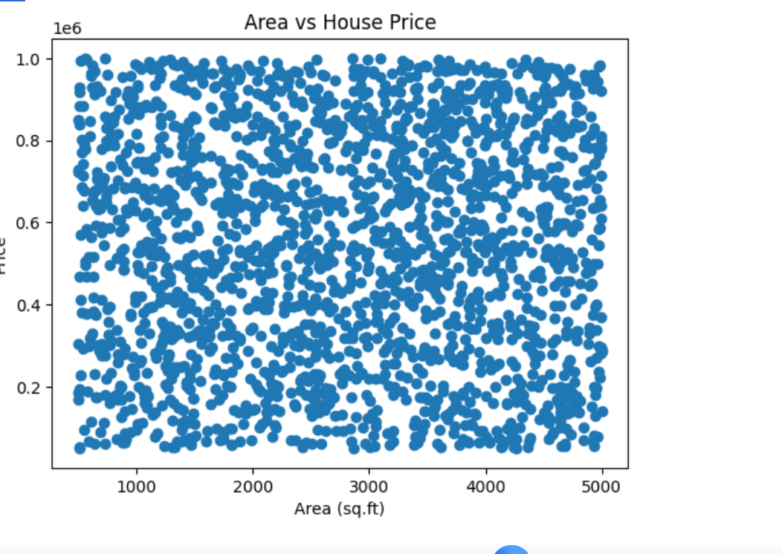

Slide 6
Conclusion
- Linear Regression predicts house price accurately
- Model learns relationship between features & price
- Can be improved using Multiple Regression, Random Forest, etc.

